Slide 1
Predicting Hospital NoShows (or “Putting Predictions to work”)
Austin Powell

Slide 2
NoShows
NoShows: Anything less than a cancellation more than 24hrs out
Implications of NoShows
Unfilled appointment cost
Cost of clinician idle time
Additional wait-time for some other patient (potentially quit sever)
Notes:
Some of the severe cases would be emergency medicine etc.

Slide 3

Create a Model

Slide 4

Features
Model
AUC > 50%

Slide 5
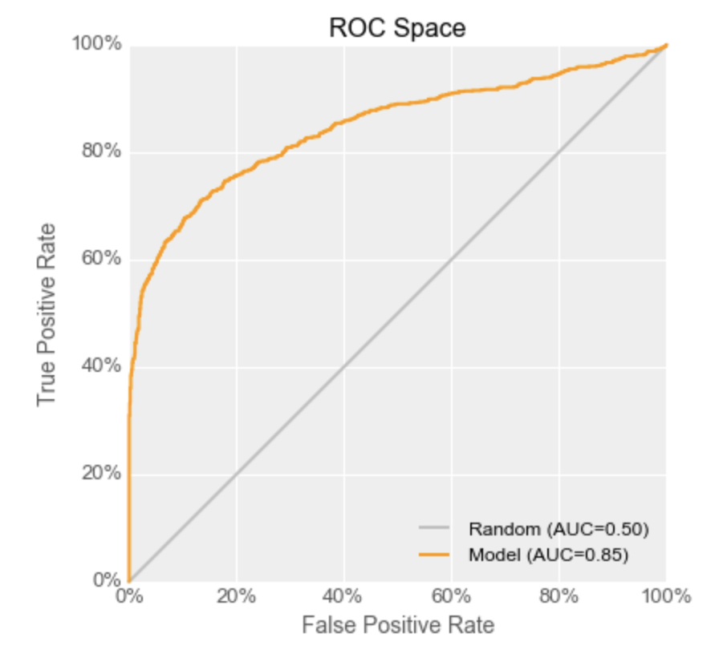
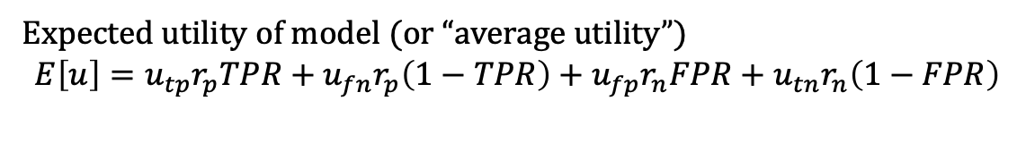
Mitigating the cost factor with a confusion matrix
NoShow Output at threshold t |  | Actual Patient NoShow
 |  | Action Needed | No Action Needed
 | Positive | True Positive Utility(t) = $ It depends Rate(t) = TPR(t) * 92% | False Positive Utility(t) = - $ call center Rate(t) = FPR(t) * 8%
 | Negative | False Negative Utility(t) = - $ operational Rate(t) = (1-TPR(t)) * 92% | True Negative Utility(t) = + $ Rate(t)=(1-FPR(t)) * 8%
Expected utility of model (or “average utility”)
$$E\left[u\right]=u_{tp}r_{p}TPR+u_{fn}r_{p}\left(1−TPR\right)+u_{fp}r_{n}FPR+u_{tn}r_{n}\left(1−FPR\right)$$

Slide 6
So you’re going to be a NoShow…

Slide 7

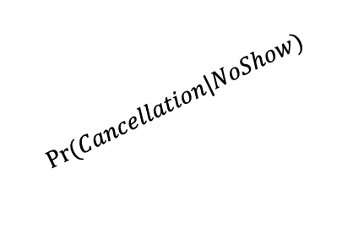
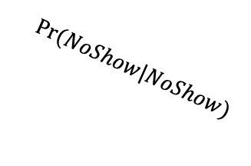
Converting NoShows
Patient
Cancellation
Keeps Appt
NoShow (at some point Bayes Error)
$$Pr⁡(Cancellation|NoShow)$$
$$Pr⁡(Keeps|NoShow)$$
$$Pr⁡(NoShow|NoShow)$$

Slide 8

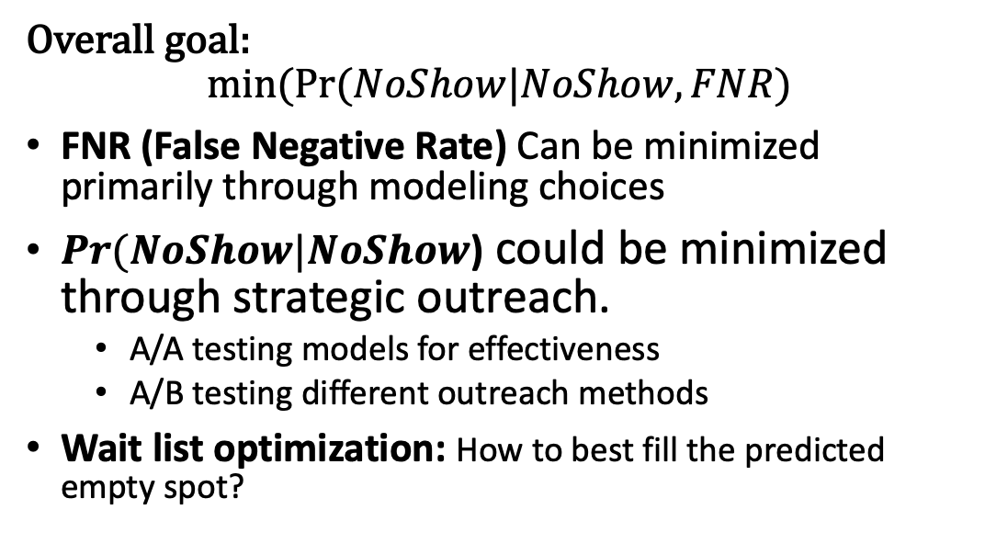
Optimization Goal
Overall goal:
$$min⁡(Pr⁡(NoShow|NoShow, FNR)$$
FNR (False Negative Rate) Can be minimized primarily through modeling choices
$Pr⁡(NoShow|NoShow$) could be minimized through strategic outreach.
A/A testing models for effectiveness
A/B testing different outreach methods
Wait list optimization: How to best fill the predicted empty spot?

Slide 9
At the end of the day…
Costs
Wait Times
Less Bias

Slide 10
Thank you!

Slide 11
Appendix
(Slides that didn’t make the cut)

Slide 12
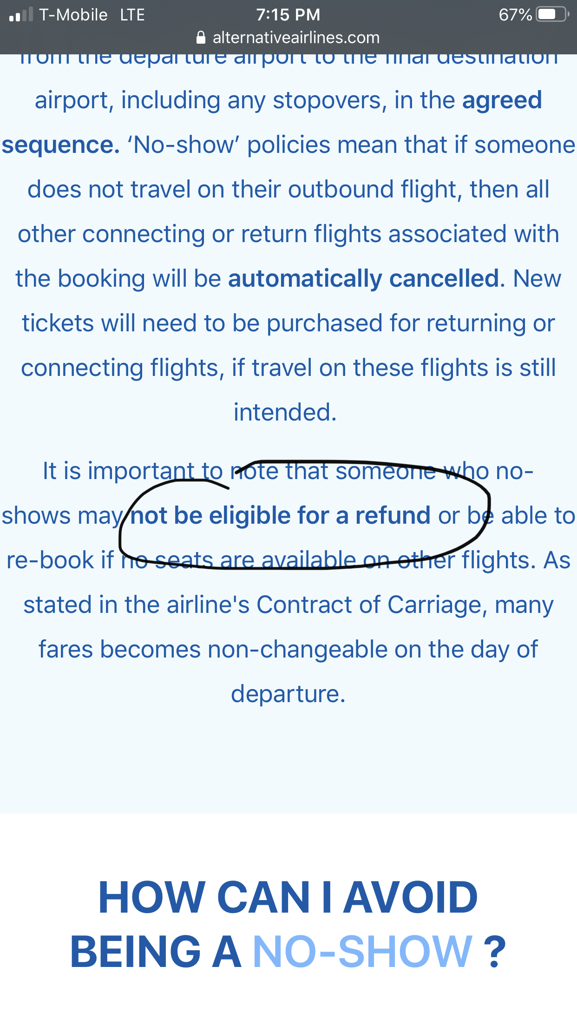
Industry Comparison: Considerations for actions
 | Airlines | Hospital
Charges | Charges up front | Charges after service
Overbooking | Yes | No
Bayes Error | < 5% | < 15%
Notes:
It’s a problem across industries. The challenge is unless you know 100% that a person is going to be a NoShow. What do you do with a probability?

